Slide 1
Data Communication and Networking (DCAN 202)
Week 8

Slide 2
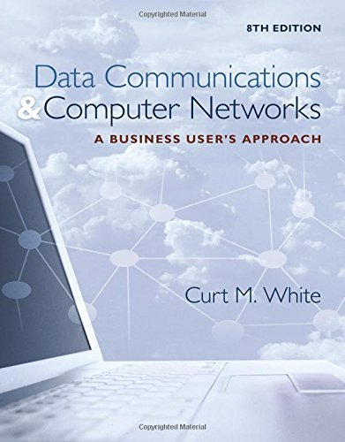
Chapter 11: Voice and Data Delivery Networks
Data Communications and Computer Networks: A Business User's Approach, Eighth Edition
© 2016. Cengage Learning. All right reserved.

Slide 3
Todays Lecture
Basic elements of a telephone system
Limitations of telephone signals
Composition of the telephone industry before and after the 1984 Modified Final Judgment
Difference between a local exchange carrier and an interexchange carrier and the services each offers
The roles of the local telephone company before and after the Telecommunications Act of 1996
Main characteristics of digital subscriber line, cable modem
Difference between a symmetric system and an asymmetric system
Basic characteristics of frame relay - permanent virtual circuits, committed information rate, and switched virtual circuits
Characteristics of Asynchronous Transfer Mode, including the roles of the virtual path connection and the virtual channel connection, the importance of the classes of service available, and ATM’s advantages and disadvantages
Concept of convergence, and several examples of it in the networking industry

Slide 4
Introduction
Students used to go into either data communications or voice communications
Today, the two fields have merged
Voice networks have given way to data networks and now data networks support both data and voice
Anyone studying the field of data communications and networks must learn some basic telecommunications too

Slide 5
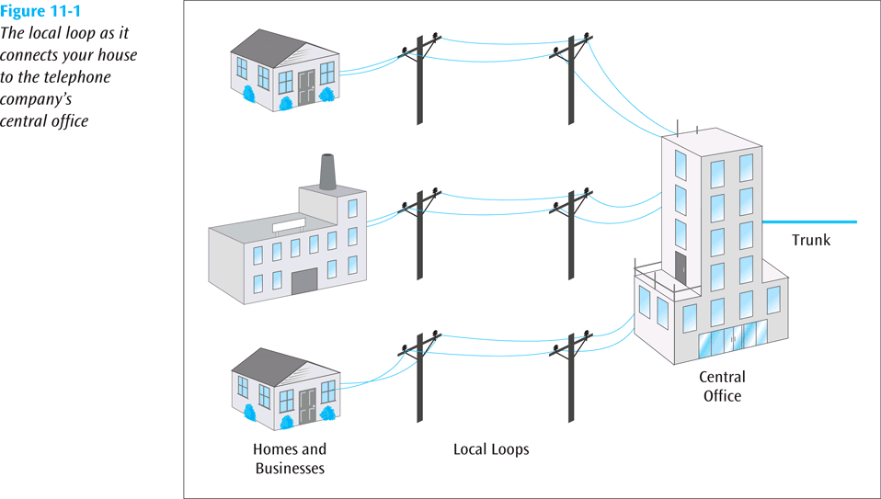
Telephone Lines, Trunks, and Numbers
The local loop is the telephone line that runs from the telephone company’s central office to your home or business
Central office – building that houses the telephone company’s switching equipment and provides a local dial tone on your telephone
If you place a long-distance call, the central office passes your telephone call off to a long-distance provider
The local loop as it connects your house to the telephone company's central office
Data Communications and Computer Networks: A Business User's Approach, Eighth Edition
© 2016. Cengage Learning. All Rights Reserved.

Slide 6
Telephone Lines, Trunks, and Numbers
The country is divided into a few hundred local access transport areas (LATAs)
If your call goes from one LATA to another, it is a long-distance call and is handled by a long-distance telephone company
If your call stays within a LATA, it is a local call and is handled by a local telephone company
Trunk – special telephone line that runs between central offices and other telephone switching centers
Usually digital, high-speed, and carries multiple telephone circuits
Typically a 4-wire circuit, while a telephone line is a 2-wire circuit

Slide 7
Telephone Lines, Trunks, and Numbers
When telephone company installs a line, it must not proceed any further than 12 inches into the building
This point is the demarcation point, or demarc
Modular connectors, such as the RJ-11, are commonly used to interconnect telephone lines and the telephone handset to the base
When handset is lifted off base (off-hook), an off-hook signal is sent to the central office
When off-hook signal arrives at central office, a dial tone is generated and returned to telephone
When user hears the dial tone, they dial (or press) number
The central office equipment collects dialed digits, and proceeds to place appropriate call

Slide 8
Telephone Lines, Trunks, and Numbers
POTS – plain old telephone service – the landline telephone system we know today
Private Branch Exchange (PBX) – common internal phone switching system for medium- to large-sized businesses
Centrex (central office exchange service) is like having a PBX but the PBX resides at the local telephone company
Private lines are leased, permanent telephone circuits; opposite of dial-up lines

Slide 9
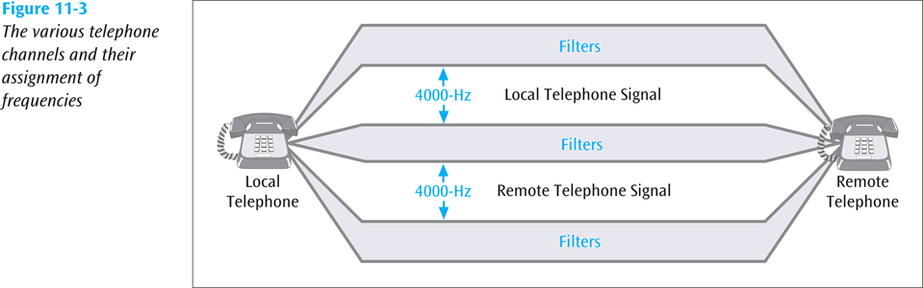
Limitations of Telephone Signals
POTS lines were designed to transmit the human voice, which has a bandwidth less than 4000 Hz
A telephone conversation requires two channels, each occupying 4000 Hz
A 4000 Hz analog signal can only carry about 33,600 bits per second of information while a 4000 Hz digital signal can carry about 56,000 bits per second
If you want to send information faster, you need a signal with a higher frequency or you need to incorporate more advanced modulation techniques
The various telephone channel and their assignment of frequencies
Data Communications and Computer Networks: A Business User's Approach, Eighth Edition
© 2016. Cengage Learning. All Rights Reserved.

Slide 10
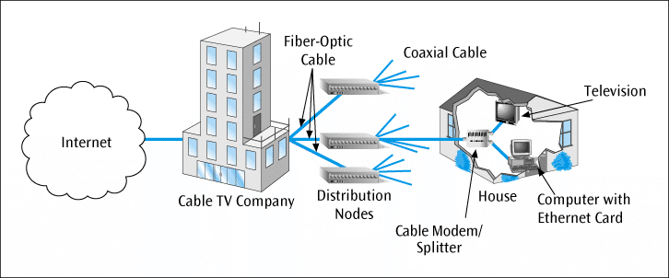
Cable Modems
Allow high-speed access to wide area networks such as the Internet
Most are external devices that connect to the personal computer through a common Ethernet card
Can provide data transfer speeds between 500 kbps and 25 Mbps
Cable modem connecting a personal computer to the Internet via a cable television connection
Data Communications and Computer Networks: A Business User's Approach, Eighth Edition
© 2016. Cengage Learning. All Rights Reserved.

Slide 11
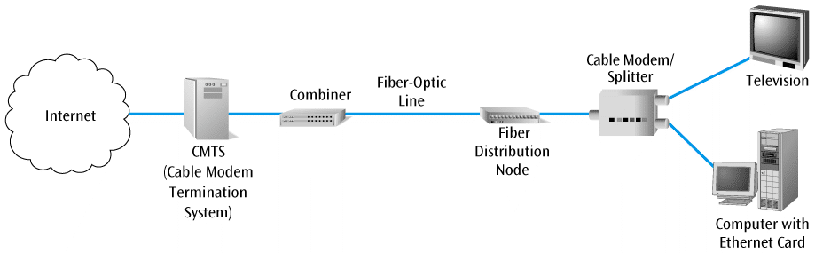
Cable Modems
Basic architecture and components of a cable modem system
Data Communications and Computer Networks: A Business User's Approach, Eighth Edition
© 2016. Cengage Learning. All Rights Reserved.

Slide 12
T-1 Leased Line Service
DSL and cable modems are great for home users and small commercial users. But what else is there for commercial users?
T-1 – digital service offered by the telephone companies that can transfer data as fast as 1.544 Mbps (both voice and computer data)
To support a T-1 service, a channel service unit / data service unit (CSU/DSU) is required at the end of the connection

Slide 13
T-1 Alternatives
There are a number of alternatives to using the often costly T-1 lines, especially for long distances
Let’s take a look at
frame relay,
asynchronous transfer mode, and
MPLS/VPN

Slide 14
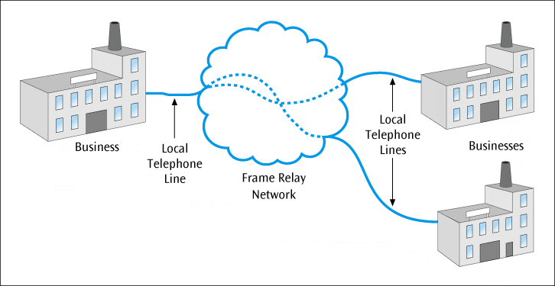
Frame Relay
Leased service that can provide a high-speed connection for data transfer between two points either locally or over long distances
A business only has to connect itself to local frame relay port
Hopefully this connection is a local telephone call
Once data reaches local frame relay port, the frame relay network, or cloud, transmits the data to the other side
Three businesses connected to the frame relay cloud via local connections
Data Communications and Computer Networks: A Business User's Approach, Eighth Edition
© 2016. Cengage Learning. All Rights Reserved.

Slide 15
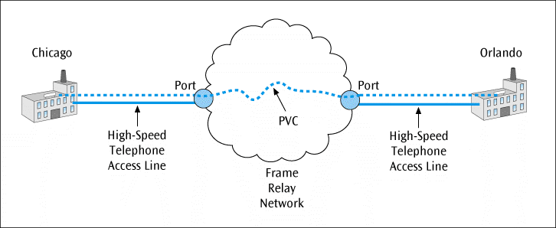
Frame Relay
Permanent virtual circuit (PVC) – connection between two endpoints
Created by the provider of the frame relay service
The user uses a high-speed telephone line to connect its company to a port, which is the entryway to the frame relay network
The high-speed line, the port, and the PVC should all be chosen to support a desired transmission speed
A frame relay connection between Chicago and Orlando, showing access lines, ports, and PVC
Data Communications and Computer Networks: A Business User's Approach, Eighth Edition
© 2016. Cengage Learning. All Rights Reserved.

Slide 16
Committed Information Rate (CIR)
The user and frame relay service would agree upon a committed information rate (CIR)
The CIR states that if the customer stays within a specified data rate (standard rate plus a burst rate) the frame relay provider will guarantee delivery of 99.99% of the frames
The burst rate cannot be exceeded for longer than 2 seconds

Slide 17
Committed Information Rate (CIR) (continued)
Example – if a company agrees to a CIR of 512 kbps with a burst rate of 256 kbps, the company must stay at or below 512 kbps, with an occasional burst up to 768 kbps, as long as the burst does not last longer than 2 seconds
If the company maintains their end of the agreement, the carrier will provide something like 99.99% throughput and a network delay of no longer than 20 ms
If the customer exceeds its CIR, and the network becomes congested, the customer’s frames may be discarded

Slide 18
Asynchronous Transfer Mode (ATM)
Asynchronous Transfer Mode (ATM) – very high-speed packet-switched service, similar in a number of ways to frame relay
Both send packets of data over high-speed lines
Both require a user to create a circuit with a provider
One noticeable difference between ATM and frame relay is speed
ATM is capable of speeds up to 622 Mbps while frame relay’s maximum is typically 45 Mbps

Slide 19
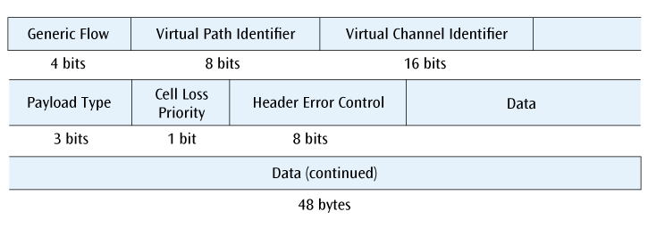
ATM Cell Composition
The 53-byte ATM cell with its individual fields
Data Communications and Computer Networks: A Business User's Approach, Eighth Edition
© 2016. Cengage Learning. All Rights Reserved.

Slide 20
Advantages and Disadvantages of ATM
Advantages of ATM include very high speeds and the different classes of service
Disadvantages include potentially higher costs (both equipment and support) and a higher level of complexity

Slide 21
Convergence
Big issue in the voice and data delivery industry
Phone companies are buying other phone companies
Older technologies are falling by the wayside as newer technologies take over a larger share of the market
Newer devices are incorporating multiple applications
Computer telephony integration is one large example of convergence

Slide 22
Computer-Telephony Integration (CTI)
Field that combines more traditional voice networks with modern computer networks
Consider a system in which a customer calls a customer support number
The customer’s telephone number appears on the customer support rep’s terminal and immediately pulls up the customer’s data
The rep answers the phone by clicking on an icon on the screen and helps the customer
The rep transfers the call by clicking on another icon on the computer screen

Slide 23
Computer-Telephony Integration (CTI) (continued)
CTI can also integrate voice cabling with data cabling
The company PBX talks directly to the LAN server
The PBX can direct the LAN server to provide a telephone operation to the user through the user’s computer
The telephones may still be connected to the PBX or they may be connected to the LAN via the LAN wiring

Slide 24
Computer-Telephony Integration (CTI) (continued)
CTI applications could include the following:
Unified messaging
Interactive voice response
Integrated voice recognition and response
Fax processing and fax-back
Text-to-speech and speech-to-text conversions

Slide 25
Computer-Telephony Integration (CTI) (continued)
CTI applications could include the following: (continued)
Third-party call control
PBX graphic user interface
Call filtering
Customized menuing systems

Slide 26
Unified Communications
Just as CTI is a convergence of multiple technologies and applications, unified communications is the convergence of real-time and non-real-time communications
For example, convergence of telephony, instant messaging, video conferencing, voice mail, e-mail, and presence information into one or more applications

Slide 27
Telecommunication Systems In Action: A Company Makes a Service Choice
Better Box Corporation has offices in Seattle, San Francisco, and Dallas, with headquarters in Chicago
Better Box wants to connect Chicago to each of the other three offices
Better Box needs to download 400k byte files in 20 seconds
This requires a transmission speed of 160,000 bps

Slide 28
Telecommunication Systems In Action: A Company Makes a Service Choice (continued)
What could Better Box use for communications?
56kbps dial-up?
T-1?
Frame relay?
ATM?
MPLS/VPN over the Internet?

Slide 29
Telecommunication Systems In Action: A Company Makes a Service Choice (continued)
56 kbps lines are too slow for our application
T-1s, frame relay, and ATM appear to be viable choices
We should be able to create a VPN using MPLS over the Internet

Slide 30
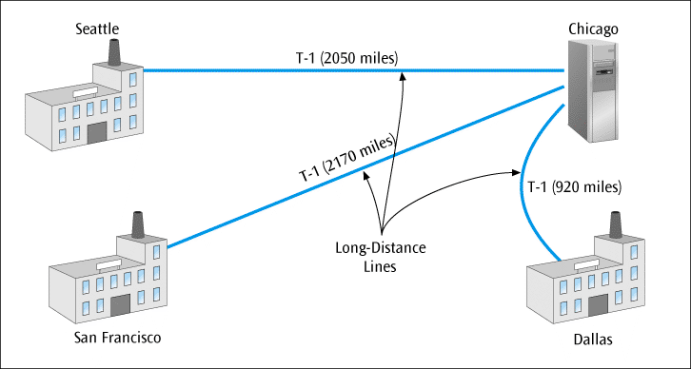
Telecommunication Systems In Action: A Company Makes a Service Choice (continued)
Three T-1 lines connecting the three regional offices to Chicago
Data Communications and Computer Networks: A Business User's Approach, Eighth Edition
© 2016. Cengage Learning. All Rights Reserved.

Slide 31
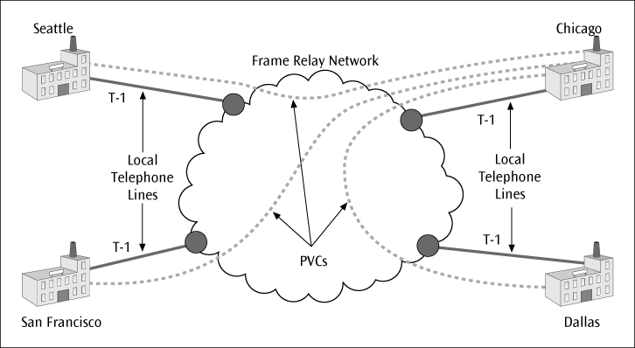
Telecommunication Systems In Action: A Company Makes a Service Choice (continued)
Four cities connected to the frame relay cloud
Data Communications and Computer Networks: A Business User's Approach, Eighth Edition
© 2016. Cengage Learning. All Rights Reserved.

Slide 32
Telecommunication Systems In Action: A Company Makes a Service Choice (continued)
Typical various prices for these services are shown on the next table
Data Communications and Computer Networks: A Business User's Approach, Eighth Edition
© 2016. Cengage Learning. All Rights Reserved.

Slide 33
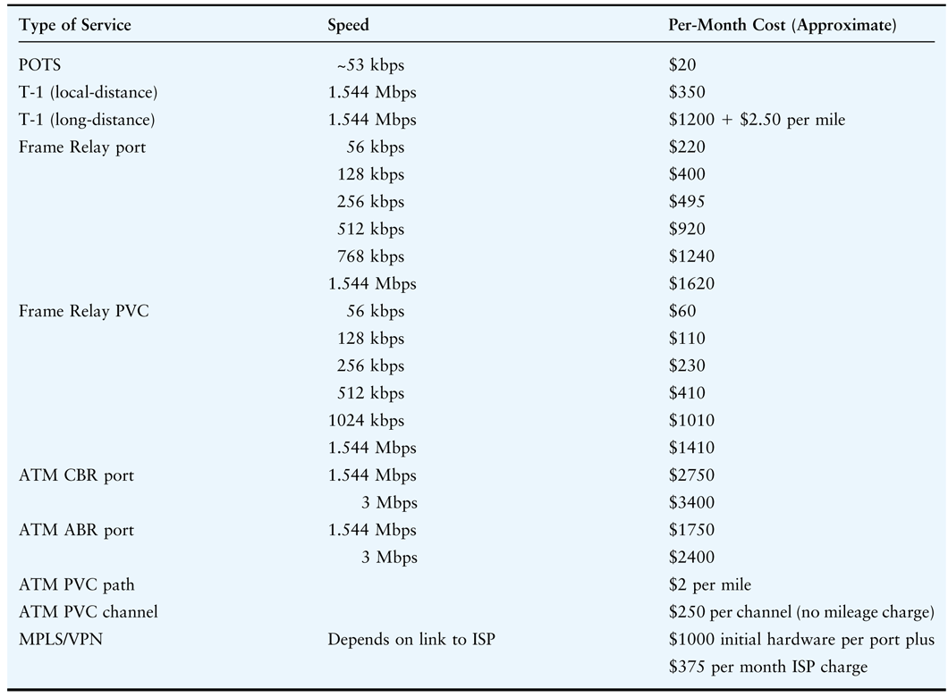
Data Communications and Computer Networks: A Business User's Approach, Eighth Edition
© 2016. Cengage Learning. All Rights Reserved.

Slide 34
Telecommunication Systems In Action: A Company Makes a Service Choice (continued)
To provide T-1 service to all four offices:
Seattle to Chicago: $6325 ($1200 + $2.50 per mile)
San Francisco to Chicago: $6625
Dallas to Chicago: $3500
Total interLATA T-1 costs = $16,450 / month

Slide 35
Telecommunication Systems In Action: A Company Makes a Service Choice (continued)
To provide frame relay service:
Three ports at 256K = 3 x $495
One port in Chicago at 512K = $920
Three 256K PVCs = 3 x $230
Four intraLATA T-1s = 4 x $350
Total charge = $4495 / month

Slide 36
Telecommunication Systems In Action: A Company Makes a Service Choice (continued)
To provide asynchronous transfer mode service:
Four ports at 1.544 Mbps ABR = 4 x $1750
Three channels = 3 x $250
Three paths = $2 per mile x 5140 miles = $10,280
Four intraLATA T-1s = 4 x $350
Total ATM charges = $19,430 / month
Data Communications and Computer Networks: A Business User's Approach, Eighth Edition
© 2016. Cengage Learning. All Rights Reserved.

Slide 37
Telecommunication Systems In Action: A Company Makes a Service Choice (continued)
To provide MPLS/VPN solution:
Initial VPN cost of $1000 per gateway per port = 4 x $1000
Monthly charge of ISP connection at each port = 4 x $375
Monthly charge of local-distance T-1 at each location = 4 x $350
Monthly charge of $2900 per month after initial $4000 fee

Slide 38
Summary
The basic telephone system that covers the U.S. is called plain old telephone service (POTS) and is a mix of analog and digital circuits
Divestiture of AT&T in 1984 opened the long-distance telephone market to other long-distance providers, forced AT&T to sell off its local telephone companies, and divided the country into local access transport areas (LATAs)
A PBX is an on-premise computerized telephone switch that handles all internal and outgoing telephone calls and offers a number of telephone services

Slide 39
Summary (continued)
A Centrex offers same services as PBX, but equipment resides on telephone company’s property, and business leases the service
Telecommunications Act of 1996 opened local telephone service to new competitors and required existing local telephone companies to provide these competitors with access to local telephone lines
Leased lines are established by communications service provider and serve as permanent, private connections between two locations
Data rate of dial-up modems using voice-grade telephone lines has peaked a little less than 56,000 bits per second.

Slide 40
Summary (continued)
Technologies such as digital subscriber line (DSL) and cable modems have improved data transfer rates available between homes and businesses and Internet service providers
T-1 service provides a digital connection of 1.544 Mbps between a company and a service provider
Frame relay is service that provides digital data transfer over long distances and at high data transfer rates (<45 Mbps)
Asynchronous Transfer Mode (ATM) is also a packet-switched service, but it supports all types of traffic and can operate at speeds faster than either T-1 or frame relay
Computer-telephony integration and unified communications are examples of convergence of data communications networks and voice systems

